Slide 1


Bank Bonus Churning Advisor
A Data-Driven Prototype for Optimizing Bank Account Bonuses
Lana Bracken
WTAMU MS-CISBA Capstone Project

Slide 2
Introduction
What is bank bonus churning?
Traditional “churn = bad” for companies → “churn = opportunity” for customers
Inspired by The Daily Churn Podcast

Slide 3
Problem Statement
Dozens of bank bonus offers exist, but they are difficult to compare manually
Consumers face information overload and uncertainty about which offers to pursue
No simple system exists to gather, rank, and recommend the best offers based on personal effort preferences
Goal: Develop a data-driven decision support tool to collect and score offers to help users focus on the most worthwhile opportunities
Future versions of the prototype may include fund rotation optimization and automated account milestone tracking.

Slide 4
Project Goals
Build a prototype - bank bonus advisor system
Recommend offers based on user preferences
Apply data analytics + software systems to personal finance opportunity

Slide 5
Data Collection
Data source: DoctorOfCredit.com (public scraping)
Used Python + BeautifulSoup
Enhanced with Gemini AI prompt engineering for structured data extraction

Slide 6
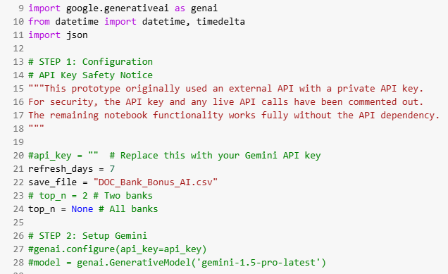
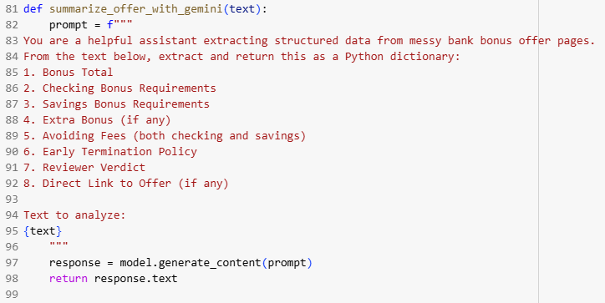
Data Collection

Slide 7
Data Cleaning
Dropped unused fields
Standardized values + created effort factor
Created clean dataset: DOC_Bank_Bonus_Cleaned.csv

Slide 8
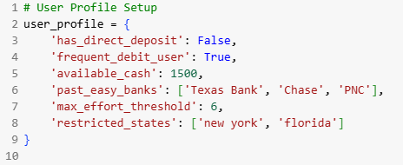
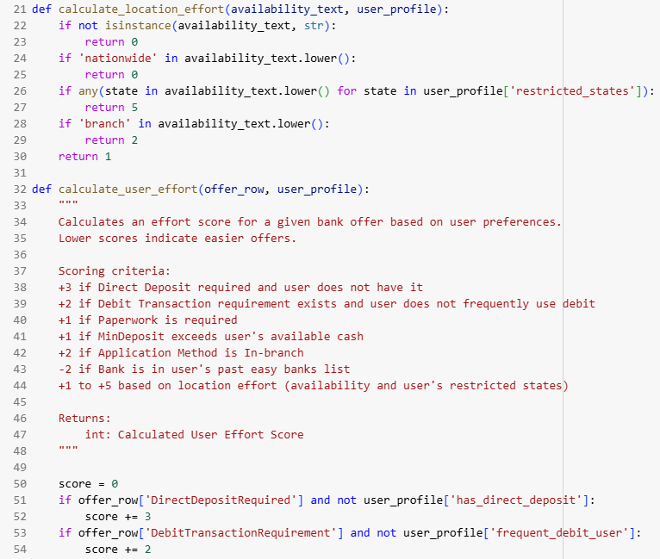
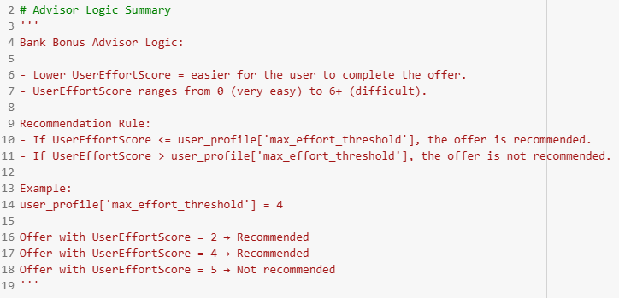
Prototype: Advisor System
user_profile: Direct deposit, debit user, cash available, restricted states, …
Calculated User Effort Score for each offer
Recommended if Score <= user threshold

Slide 9
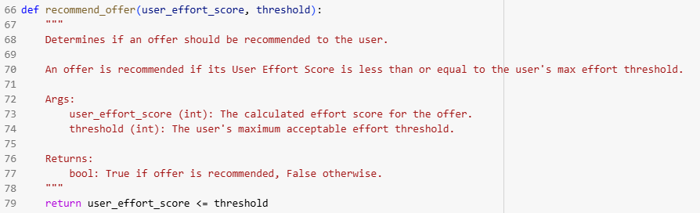
Prototype Demo: Recommendations

Slide 10
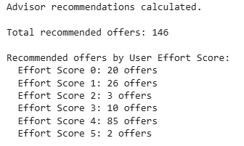
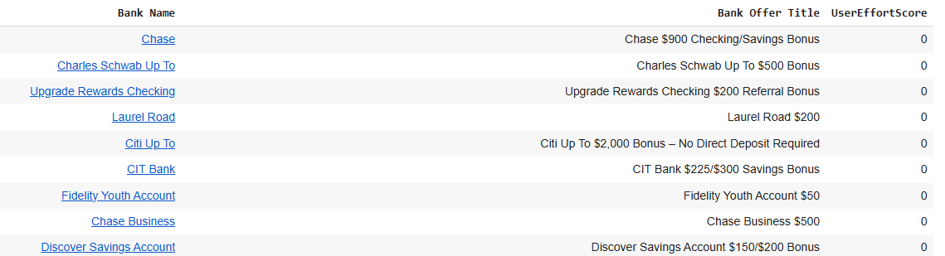
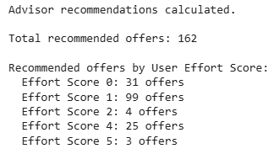
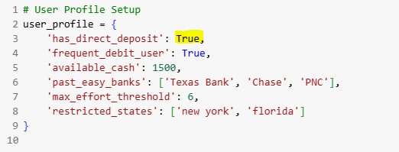
Prototype Demo: Recommendations

Slide 11
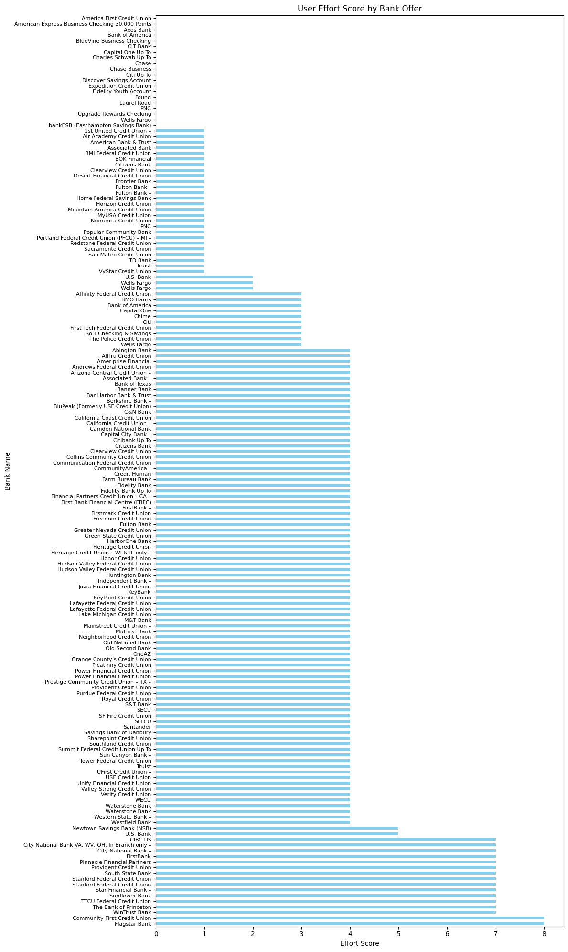
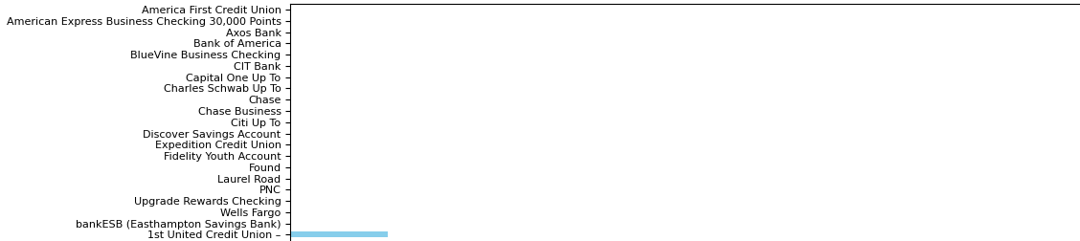
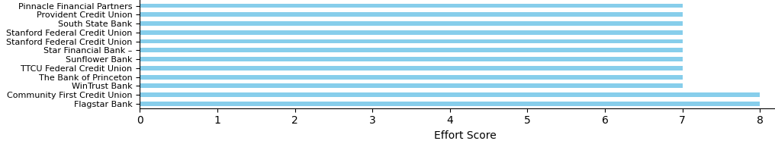
Prototype Demo: Visualization

Slide 12


Cybersecurity Reflection
Opening many accounts = attack surface expansion
Mitigation: Password manager, 2FA, account separation
Aligns with Cybersecurity coursework

Slide 13
Future Work
Add Seed Fund Optimizer to automate fund rotations
Add API integrations (Empower) to track transactions
Expand notebook to interactive web/mobile app
Push for standardized data in churning community

Slide 14
Conclusion
Prototype: tracked & recommended bank bonus offers
Synthesized skills from
Data Analytics
Data Management
Software Systems
Networking & Cybersecurity
Git Hub link: https://github.com/wtamu-babb/CIDM6395-Spring2025-LanaBracken/tree/main/SynthesisPrototypeProjectDemo

